Slide 1

Learn Finnish Adventure Game
Project proposal for an Educational language learning game,
29,07,2024 – Ali Gadraoui

Slide 2
Project Overview
An educational game to help non-Finnish speakers learn Finnish.
Engaging, interactive platform with progressive learning.
Focuses on vocabulary, grammar, conversational skills, and cultural immersion.

Slide 3
Objectives
Engage learners through interactive and fun gameplay.
Teach Finnish language basics and advanced skills.
Provide cultural context and immersion.
Scalable development for continuous updates.

Slide 4
Game Structure Sample
Introduction Level: Basic greetings and cultural context.
01
Level 1: Daily life vocabulary.
02
Level 2: Shopping and numbers.
03
Level 3: Travel and directions.
04
Level 4: Social interactions.
05
Final Level: Finnish culture quest.
06

Slide 5
Development Plan
Phase 1
Design and Planning
Phase 2
Initial Development
Phase 3
Content Creation
Phase 4
Testing and Feedback
Phase 5
Launch and Distribution
Phase 6
Continuous Improvement

Slide 6
Project Timeline
Month 1: Planning and initial design.
Month 2-3: Basic development and creation of introductory levels.
Month 4-5: Content creation and development of intermediate levels.
Month 6: Testing, feedback collection, and initial launch.
Ongoing: Continuous updates and addition of advanced content.

Slide 7
Team Structure
Project Manager: Ali Gadraoui
Game Designer
Developer/Programmer
Graphic Designer/Animator
Content Creator/Writer
Audio Specialist
Language Expert/Consultant
Quality Assurance (QA) Tester

Slide 8

Roles & Responsibilities
Project Manager: Coordination, timelines, communication.
Game Designer: Mechanics, rules, progression.
Developer/Programmer: Game development, debugging.
Graphic Designer/Animator: Visual assets, animations.
Content Creator/Writer: Educational content, dialogues.
Audio Specialist: Audio content, pronunciation guides.
Language Expert: Language accuracy, cultural insights.
QA Tester: Bug identification, user feedback.

Slide 9
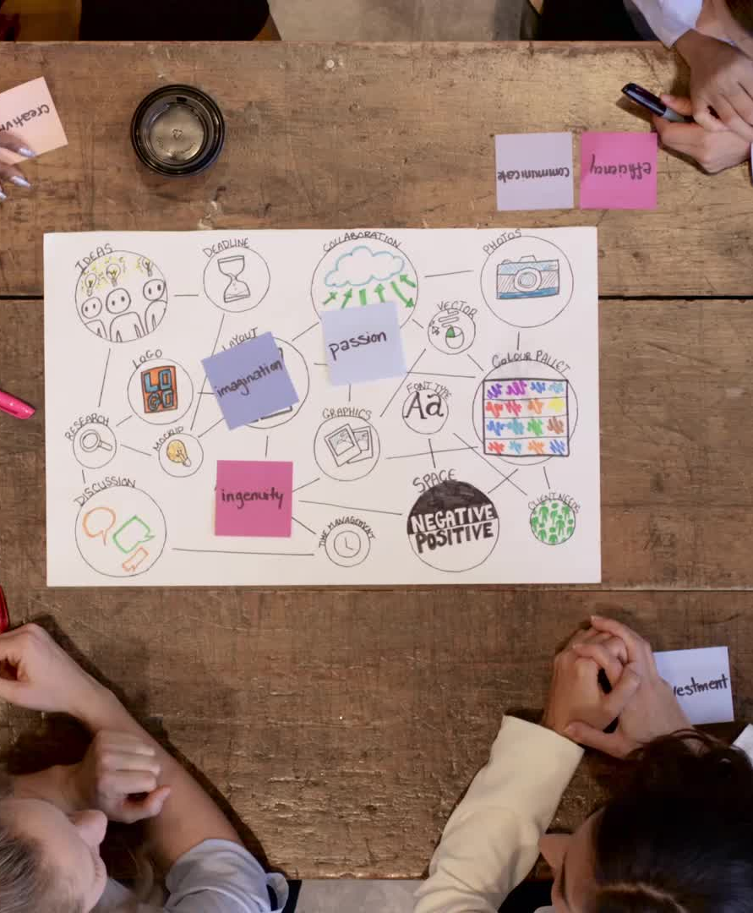
Collaboration tools
Communication: Discord, Microsoft Teams
Version Control: GitHub, GitLab
Design Collaboration: Figma

Slide 10
Software tools
Game Development: Unity or Unreal Engine + Ren’Py
Graphic Design: Adobe Creative Suite
Audio Editing: Audacity or Adobe Audition

Slide 11
Benefits
Engaging Learning Experience: Makes learning Finnish fun and interactive.
Cultural Understanding: Provides context to language learning.
Scalability: Allows for continuous development.
Portfolio Enhancement: Showcases development and educational design skills.

Slide 12

Conclusion
The "Learn Finnish Adventure" game aims to create an engaging and educational tool for non-Finnish speakers.
The project is manageable for an IT student and allows for gradual development.
With clear roles and responsibilities, the team can develop a high-quality educational game.
This project will enhance language learning and showcase your project management skills.

Slide 13

Questions

